Slide 1
Performance-Review
Date:19/06/2024
Name: Vamshi Krishna Emmadi
Evaluating Prof: Prof. Partha Saha
Department @Bajaj : CAE Power Train
Reporting Manager: Mr. Tagore Janaswamy

Slide 2
Agenda
Problem Statement
Approach
Project Overview
Literature Survey
CNN Architectures (Methods to solve)
Data Generation
Results

Slide 3
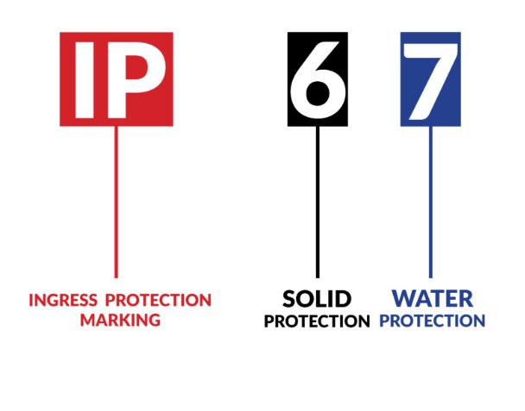
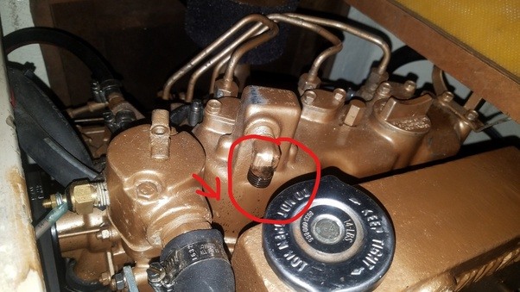
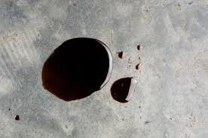
Problem Statement
1) Crank seal oil leaks can cause serious damage to a bike engine.
2) Checking IP67 Compliance is important factor:
To avoid oil leakages
To ensure prevention of entrance of foreign
particles which may lead to corrosion of inner parts of assembly.

Slide 4
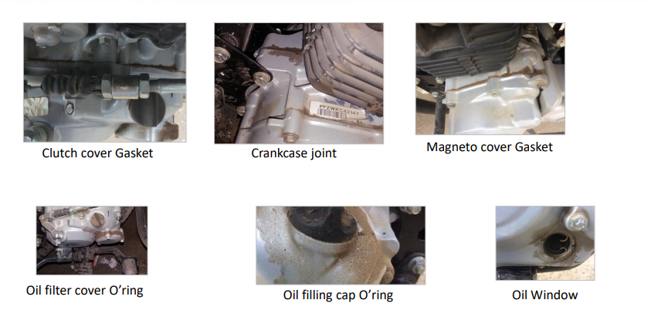
Problem Statement
Engine oil Seepage:

Slide 5
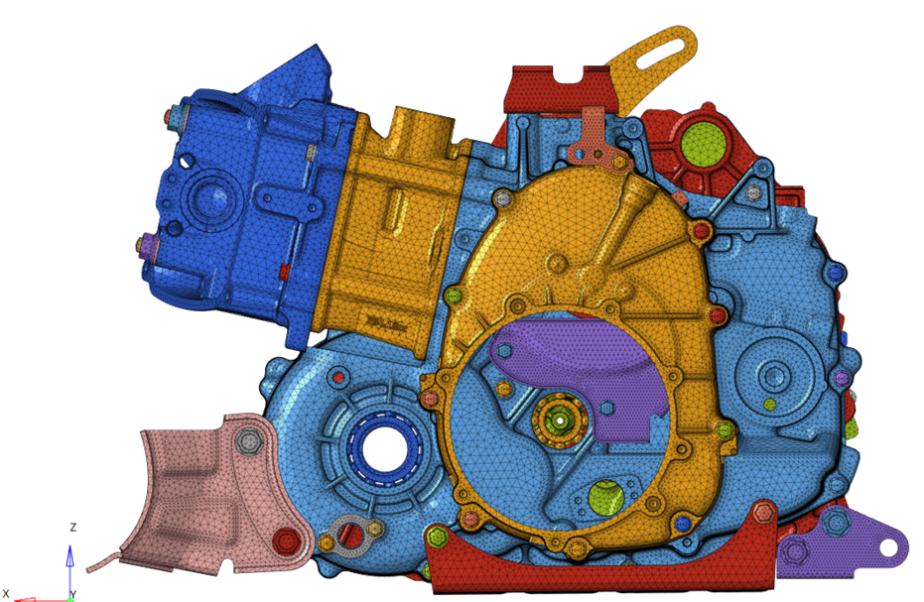
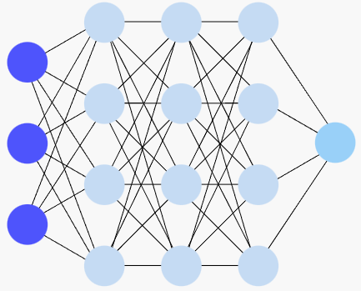
Approach
1)Leakage happens through zero contact pressure points, checking zero contact pressure points through CAE/FEA (Virtual testing) takes around 20 hours.
2)Using Artificial Intelligence, we can predict contact pressures in minutes!!
3)We can train and use a machine learning model which can predict contact pressures for any contact surface in a much lesser time.
CAE - 20HOURS APPROX.
ML MODEL – 1 MIN

Slide 6
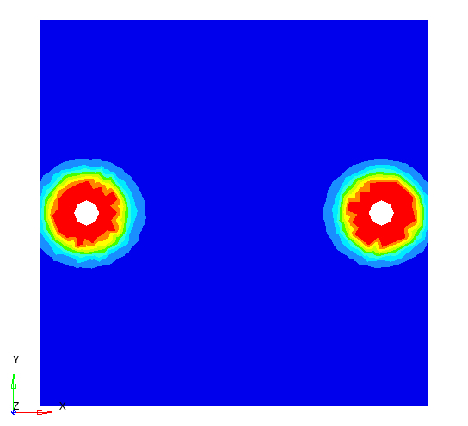
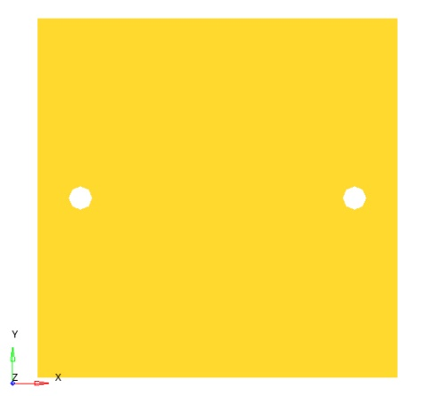
Project Overview
Project Title:
Machine Learning based approach for predicting sealing pressure to achieve IP67 compliance
Key Deliverables:
Contact pressure prediction through machine learning algorithm for a given project application and correlation with CAE results
Bolt load, pitch, material, width etc..
ML MODEL
Input sample (image+text)
Output sample (image)

Slide 7
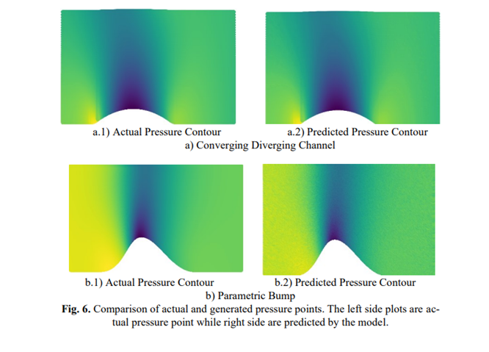
Literature Survey
Extraction of Flow Features for Predicting Pressure Distribution Using Convolutional Neural Networks (CNNs):
By Prince Tyagi, Priyam Gupta and Raj Kumar Singh

Slide 8
CNN Architectures
Encoding-Decoding Architecture:
Image
Image Vectors
Text Vectors
Concatenated vectors
Image Encoder
Transpose CNN
Output Image
Inputs
Text
Text Encoder
output
Combined vectors
Encoder
Decoder

Slide 9
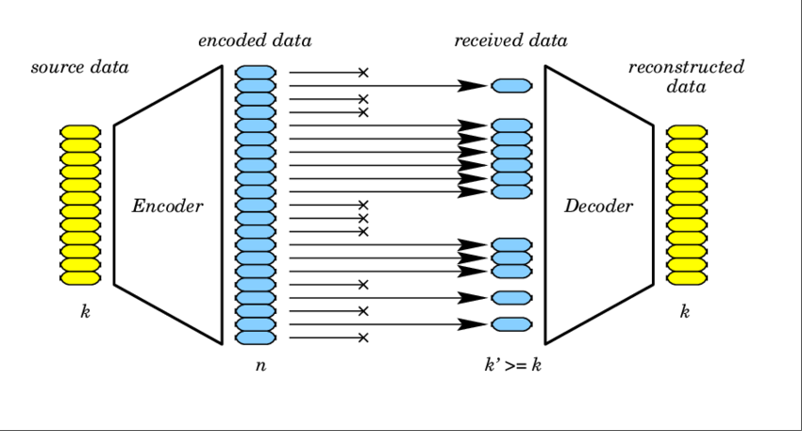
CNN Architectures
Encoding-Decoding Architecture:

Slide 10
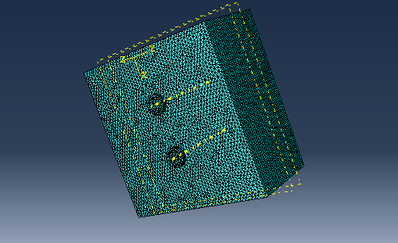
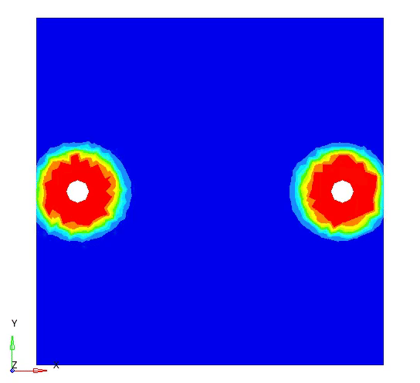
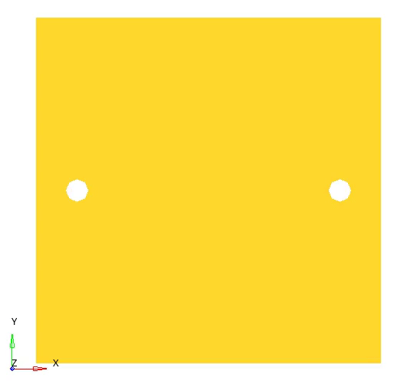
Data Generation
FEA
Output images
Input Images

Slide 11
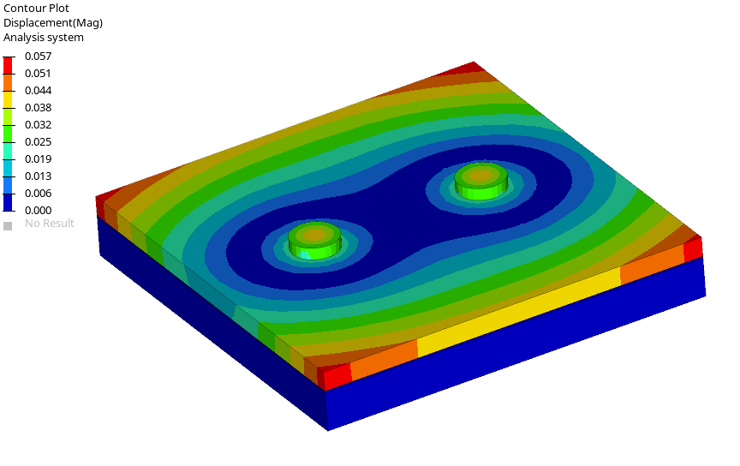
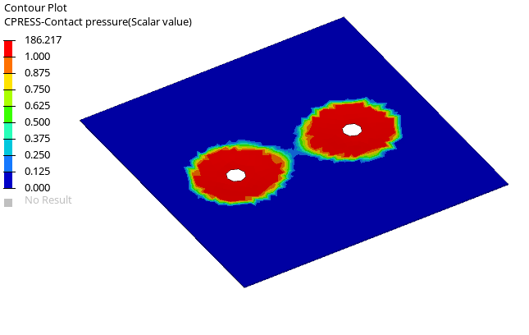
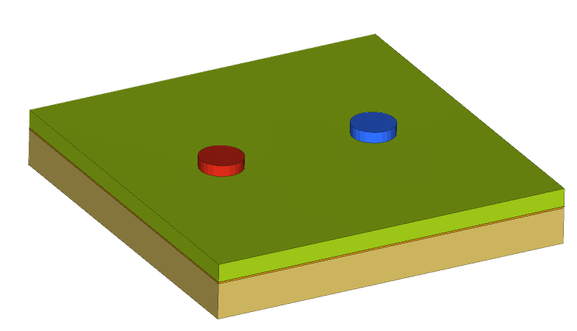
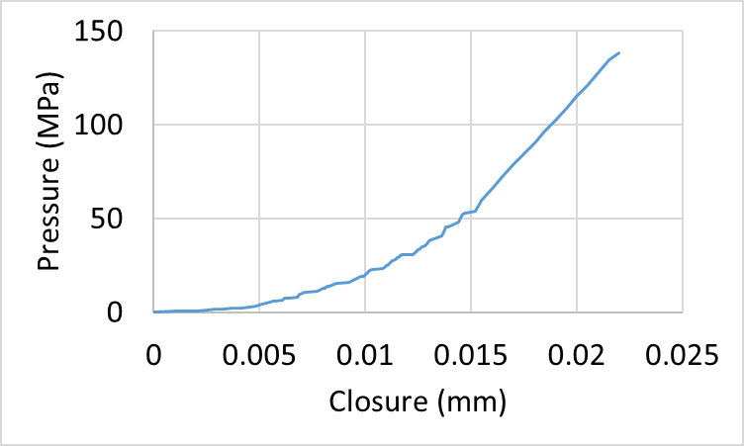

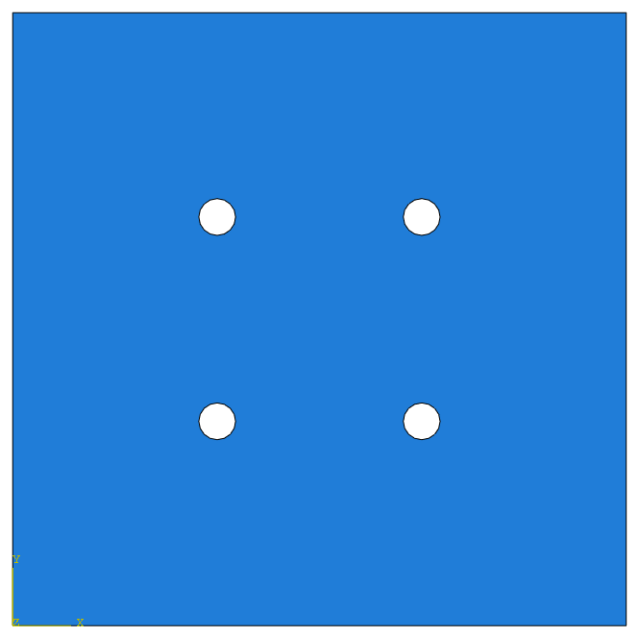


Data generation Methodology
2 bolt configuration
Displacement Animation
Contact Pressure
Bottom & top aluminum plates
NAM32 paper gasket
2 bolt configuration
4 bolt configuration
6 bolt configuration
9 bolt configuration
NAM32 properties
W-xp
W-xp
W-xp
W-xp
H
xp
H
xp
H
W/2
H
W/2
yp
H-yp
H-yp
H-yp
H-yp
yp
xp
yp
xp
yp
H/2
W
W
W
W

Slide 12
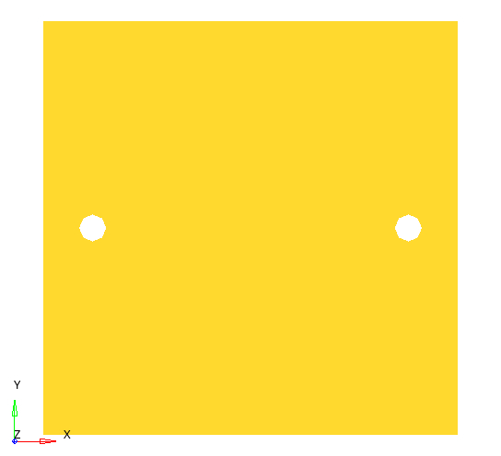
Data Generation Input Image & Data
Sample input image
Sample text description
Xp/W
W-xp
Sample output image
0.12, 6000
H
xp
yp
H-yp
810 input images and corresponding 810 output images and their associated text descriptions are generated.
Bolt Load
W

Slide 13
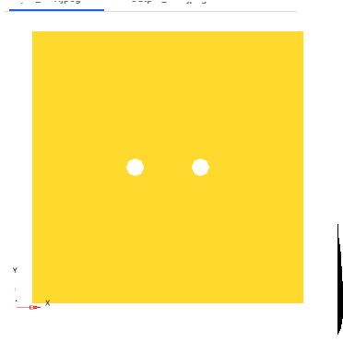
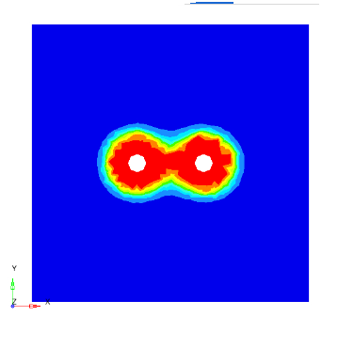
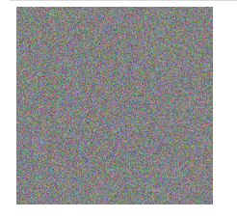
Encoding – decoding - Method

Slide 14
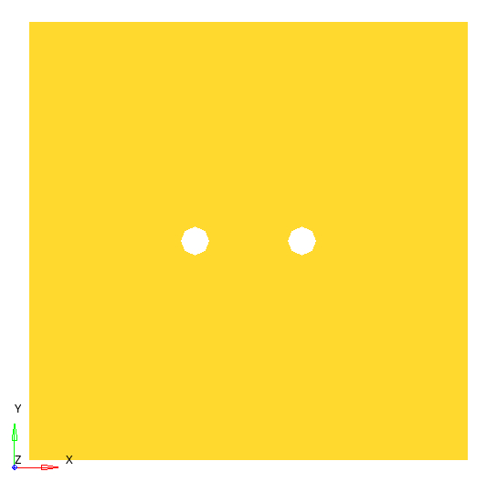
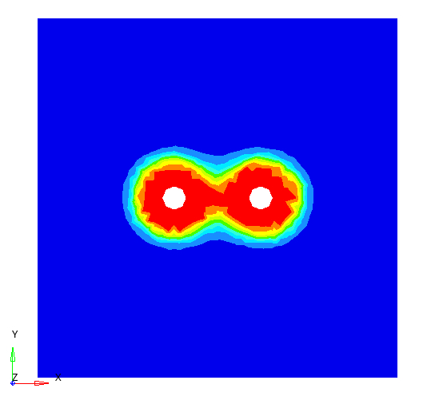
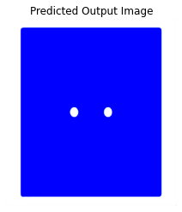

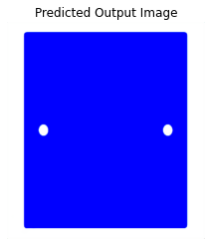
Direct CNN – Image to Image (with padding loads)

Slide 15
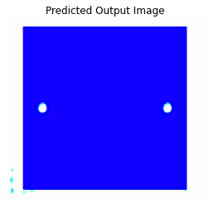
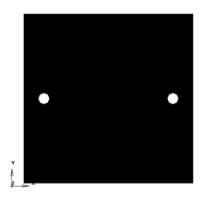
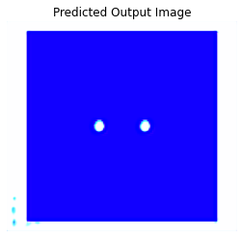

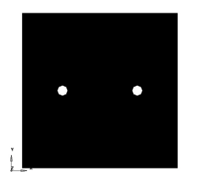
Masked Images - CNN

Slide 16
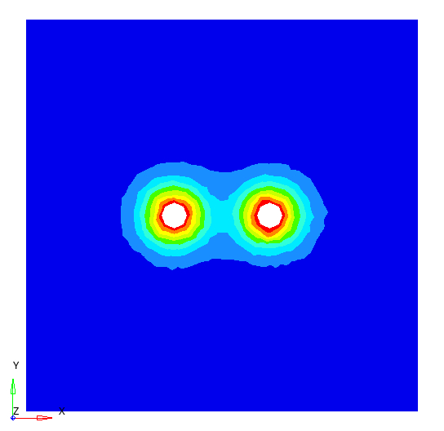
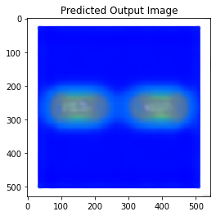
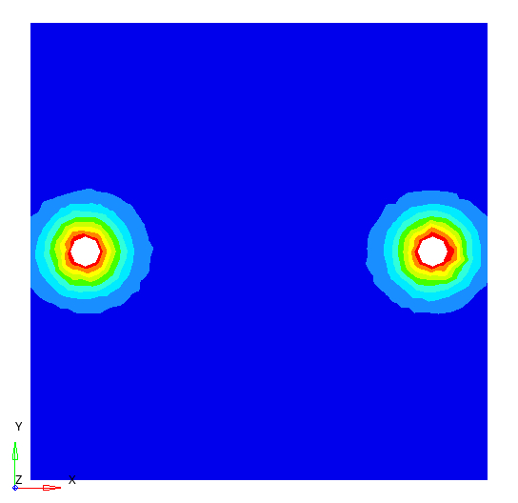

Encoder-decoder(multiple layers)(Image-vector-Image)

Slide 17
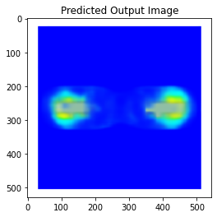
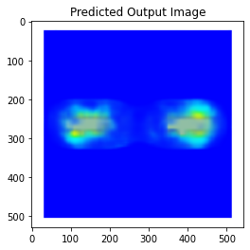
1-encoder-multiple decoders(Image-vector-Image)

Slide 18
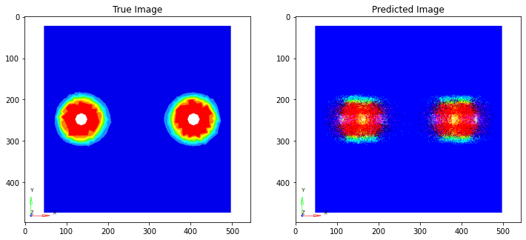
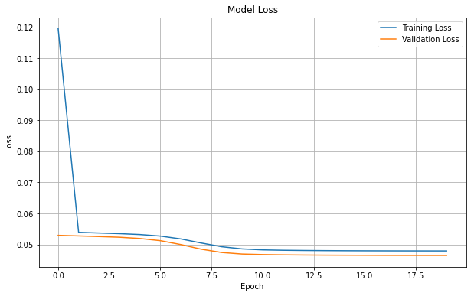
Flatten()+Decoder Method
Conclusion:
Final Result: Out of all the models, this model gave the highest accuracy that is 91.7% exactly, So we can use this model to predict contact pressures at different contacts of any 3D Model, and the points with zero contact pressure are the ones prone to leakage, so an engineer can focus on those points to ensure IP67 rating.

Slide 19
Thank You

